Slide 1
Rearranging Power Equation and teach examples

Slide 2
Learning Objectives
I can mathematically rearrange the power equation.
I can calculate power using the formula.
Notes:
In this lesson, students will learn the definitions of both potential and kinetic energy. They will also be able to give examples of each and explain how potential energy changes into kinetic energy.

Slide 3
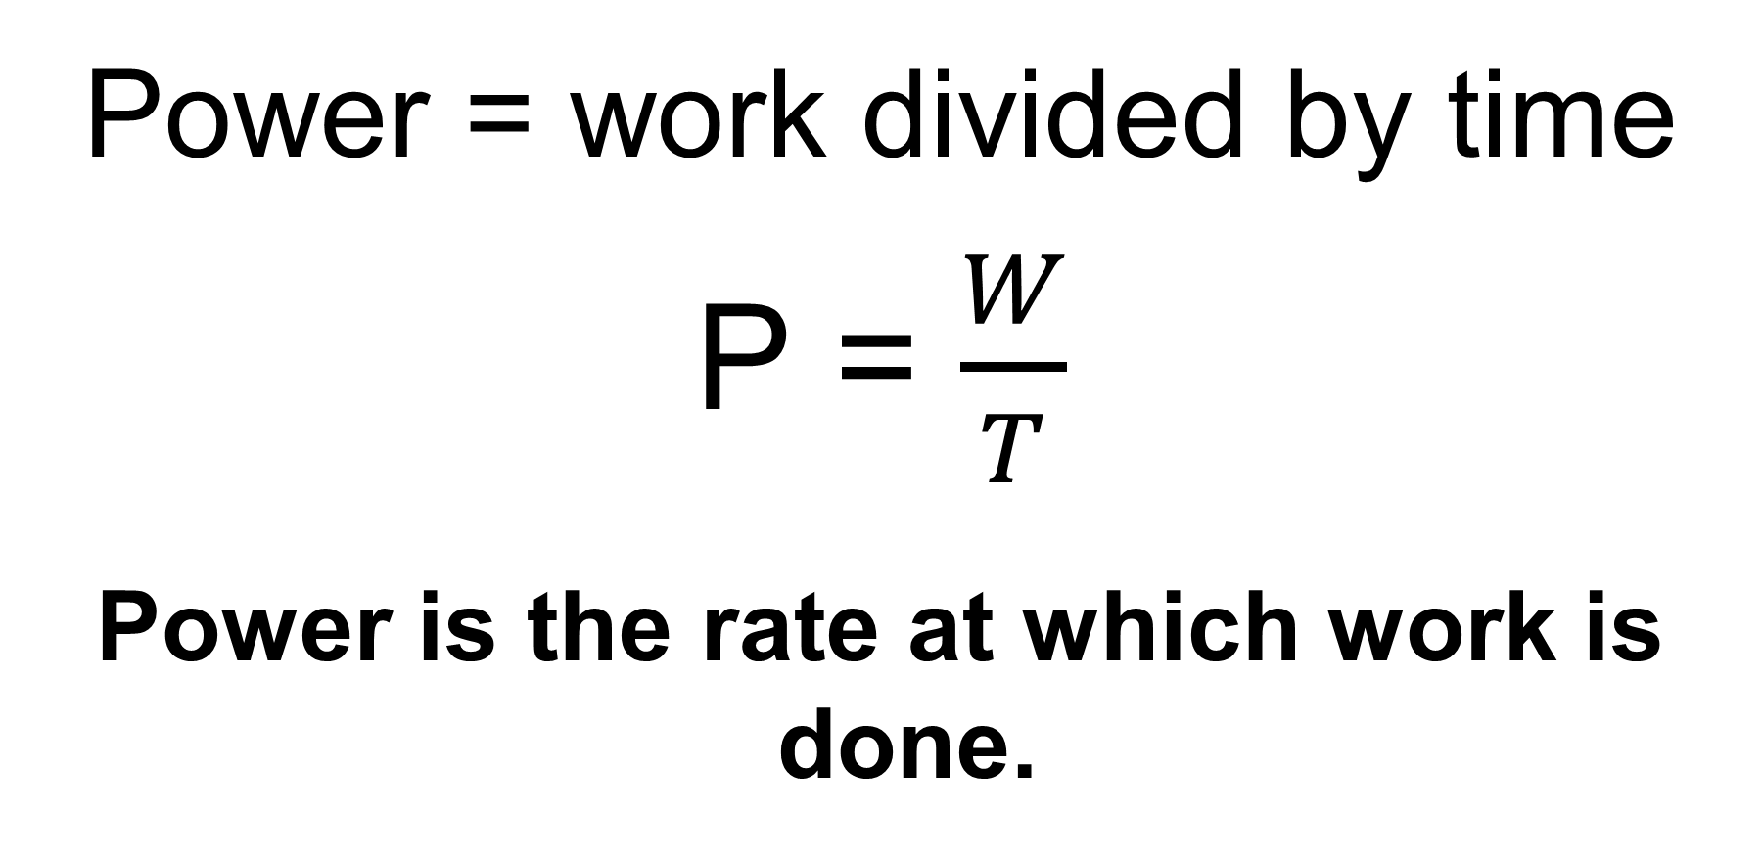
Calculating Power
Power = work divided by time
P = $\frac{W}{T}$
Power is the rate at which work is done.
joules
Watts
seconds

Slide 4
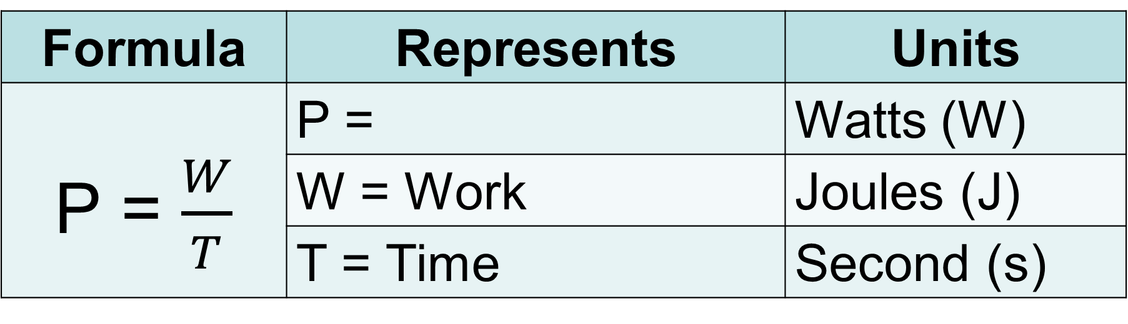
Formula Representation
Formula | Represents | Units
P = $\frac{W}{T}$ | P = | Watts (W)
 | W = Work | Joules (J)
 | T = Time | Second (s)
Power

Slide 5
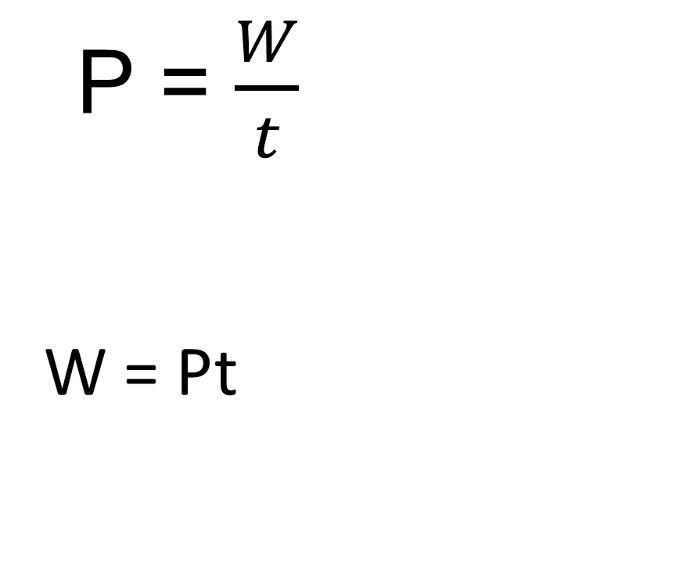
Solve for Work (W)
P = $\frac{W}{t}$
W = Pt
Step 1 – Multiply both sides by t - time
(t)
(t)

Slide 6



Solve for Time (t)
P = $\frac{W}{t}$
Step 1 – Multiply both sides by t – time
Step 2 – Divide by P - power on both sides.
(t)
(t)
W = Pt
__
P
__
P
t = $\frac{W}{P}$

Slide 7
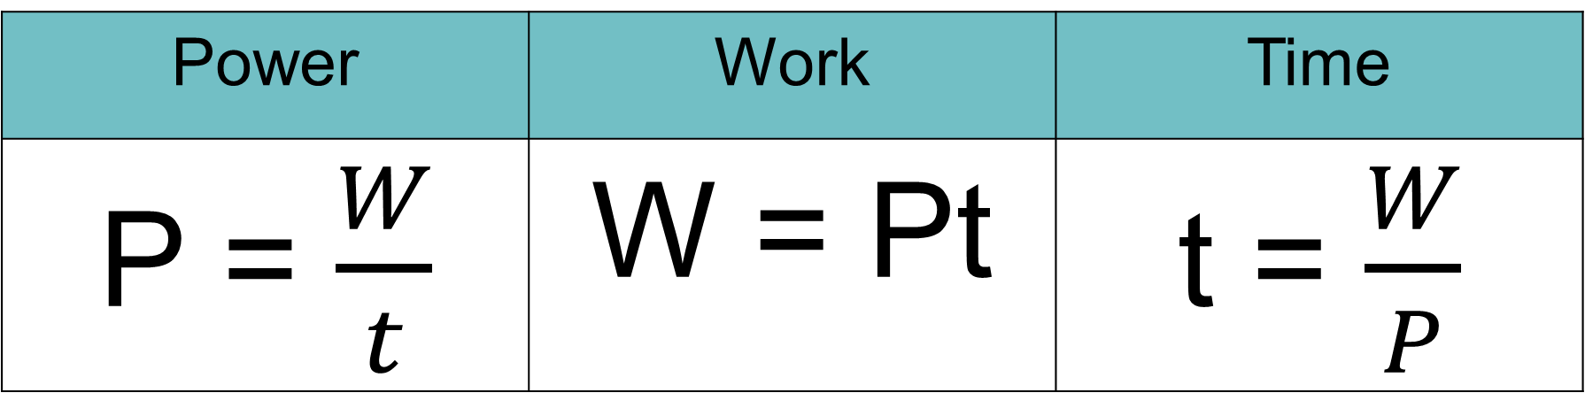
Power Related Equations
Power | Work | Time
P = $\frac{W}{t}$ | W = Pt | t = $\frac{W}{P}$

Slide 8



Calculation Example #1
1. A weightlifter lifts a barbell in 3s and does 2,400J of work. How much power was used to lift the barbell?
Given/ Unknown | Work
P = W = t =
?
2,400J
$$P=\frac{W}{t}$$
$$P= \frac{2,400j}{3s}$$
$$P=800W$$
3s

Slide 9



Calculation Example #2
2. A student rows a boat across a still pond, using a power of 60W and takes 60s. What is the work done by the student?
Given/ Unknown | Work
P = W = t =
60W
?
$$W=Pt$$
$$W=(60W)\left(60s\right)$$
$$W=3600J$$
60s

Slide 10



Calculation Example #3
3. The power of a small motor is 180W and will do 4500J of work in how much time?
Given/ Unknown | Work
P = w = t =
180W
4500J
$$t=\frac{W}{P}$$
$$t= \frac{4,500j}{180W}$$
$$t=25s$$
?

Slide 11

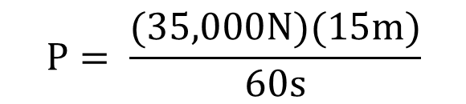



Calculation Example #4
4. A crane lifts a 35,000N steel girder a distance of 15m in 1minute. How much power did the crane require to lift the girder? Write your answer in kilowatts
Given/ Unknown | Work
P = f = t = d =
?
1st convert the time into seconds
1min=60seconds
35,000N
$$P=\frac{W or (fd)}{t}$$
$$P= \frac{(35,000N)(15m)}{60s}$$
$$P=\frac{525,000J}{60s}$$
$$P=8750W$$
1min
or 60s
15m
2nd convert the watts to kilowatts
1000w = 1kw
$$P=8.750kW$$

